Slide 1


CS20: TensorFlow for Deep Learning Research
Lecture 12 (2/23/2014) Machine Translation, Sequence-to-sequence and Attention
Slides courtesy of CS22N

Slide 2
Assignment 3
Chat bot
Language model
Word vector transformation
Project of choice

Slide 3
Overview
Today we will:
Introduce a new task: Machine Translation
Introduce a new neural architecture: sequence-to-sequence
Introduce a new neural technique: attention
is the primary use-case of
is improved by

Slide 4
Machine Translation
Machine Translation (MT) is the task of translating a sentence x from one language (the source language) to a sentence y in another language (the target language).
x: L'homme est né libre, et partout il est dans les fers
y: Man is born free, but everywhere he is in chains
Notes:
Rousseau
European bias in this lecture

Slide 5
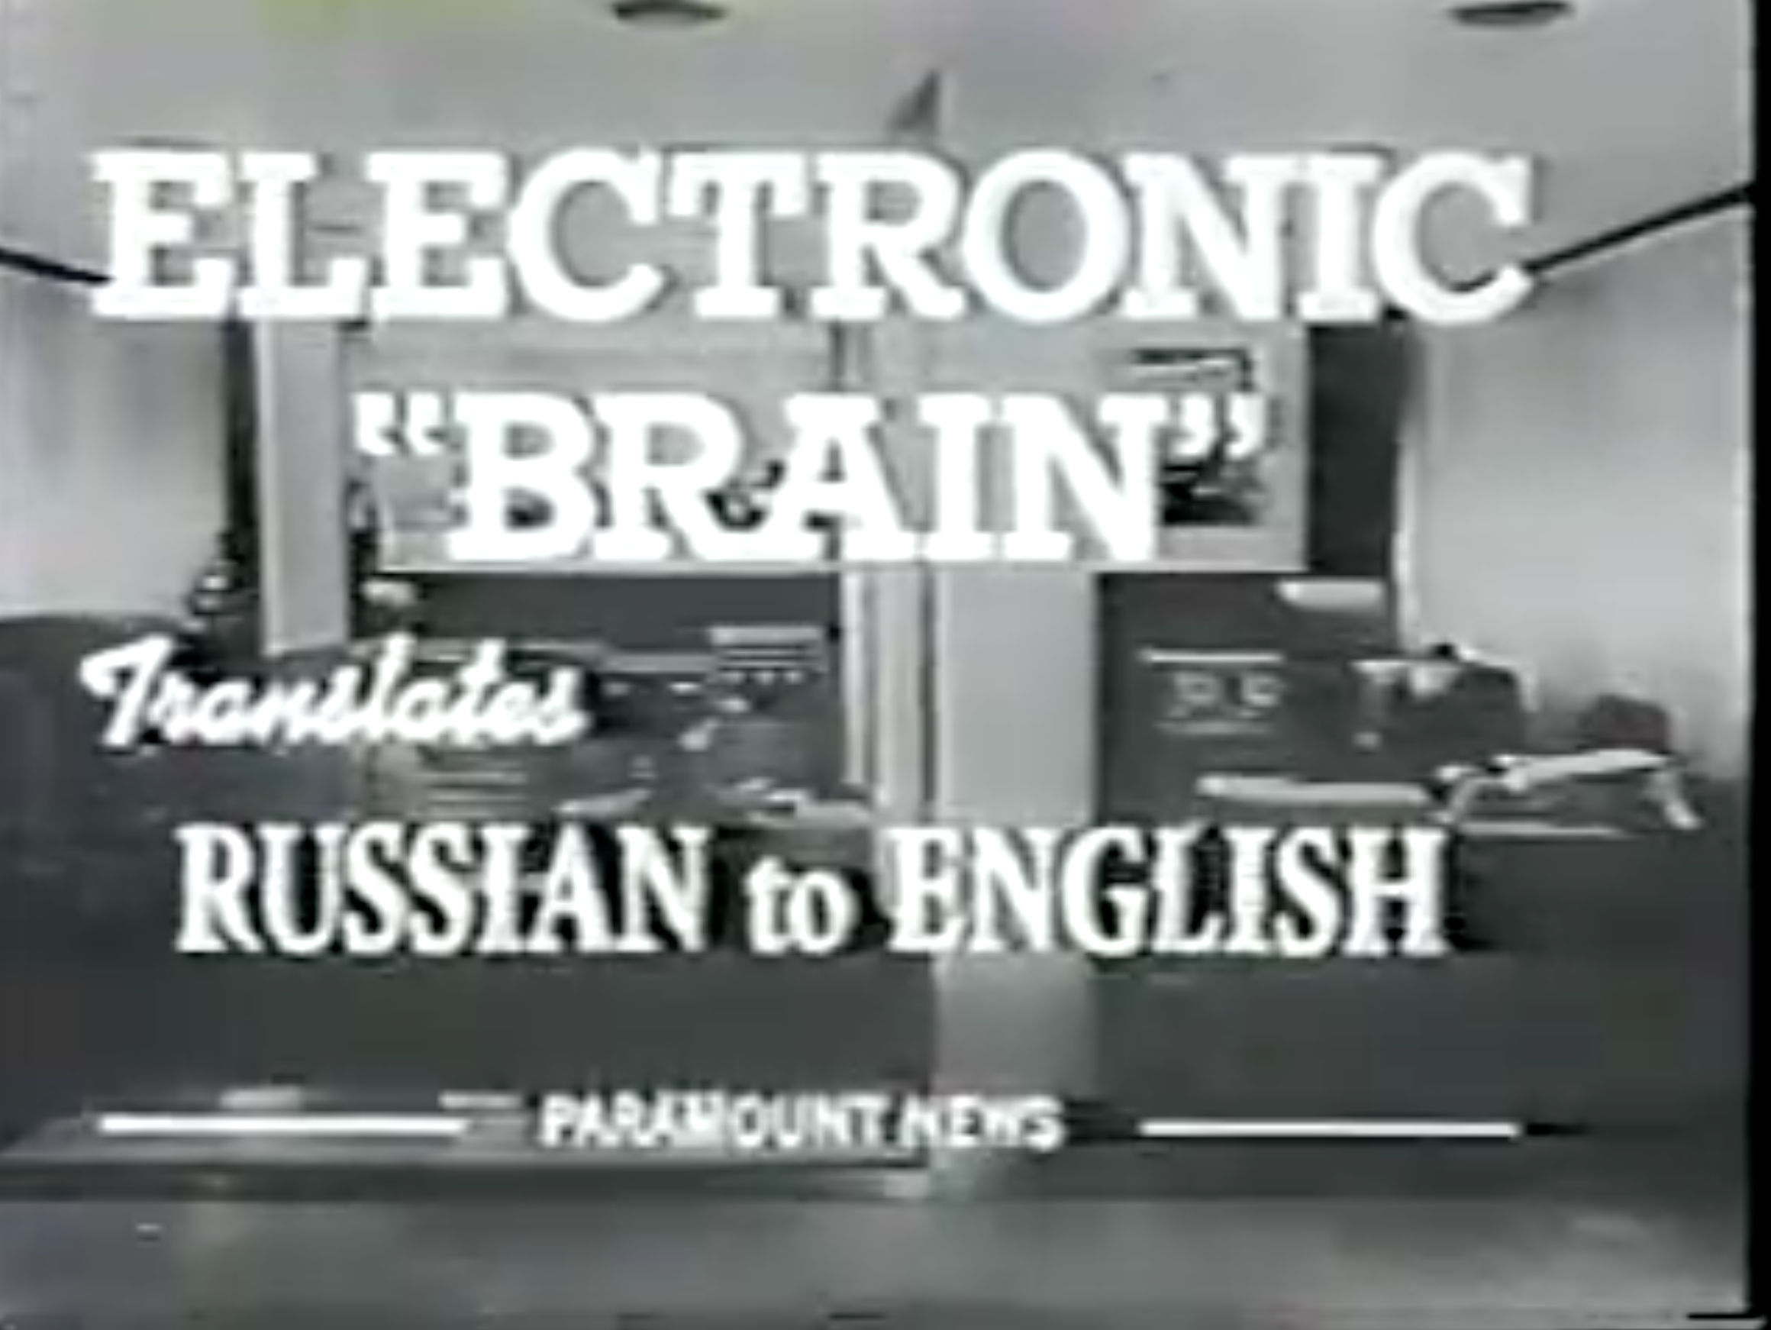
1950s: Early Machine Translation
Machine Translation research began in the early 1950s.
Mostly Russian → English (motivated by the Cold War!)
Systems were mostly rule-based, using a bilingual dictionary to map Russian words to their English counterparts
A cool by-product: Quicksort!
Source: https://youtu.be/K-HfpsHPmvw

Slide 6
1990s-2010s: Statistical Machine Translation
Core idea: Learn a probabilistic model from data
Suppose we’re translating French → English.
We want to find best English sentence y, given French sentence x
Use Bayes Rule to break this down into two components to be learnt separately:
Translation Model Models how words and phrases should be translated. Learnt from parallel data.
Language Model Models how to write good English. Learnt from monolingual data.
Notes:
LM worries about target word order so translation model doesn't have to

Slide 7
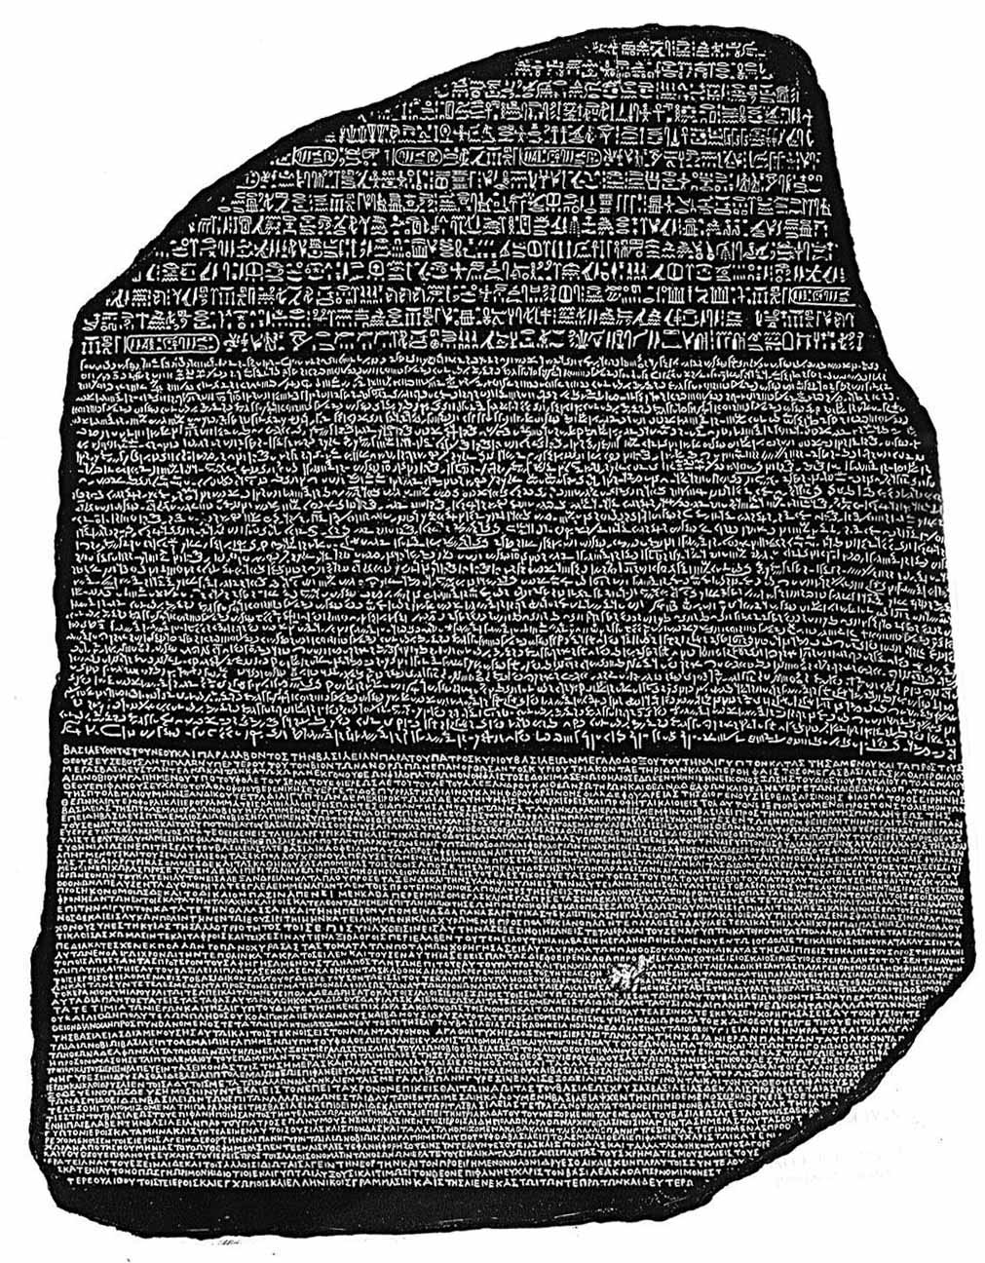
1990s-2010s: Statistical Machine Translation
Question: How to learn translation model ?
First, need large amount of parallel data (e.g. pairs of human-translated French/English sentences)
The Rosetta Stone
Ancient Egyptian Demotic Ancient Greek
Notes:
First parallel text for Ancient Egyptian
Rosetta Stone helped 19th century scholars decipher Ancient Egyptian hieroglyphs for the first time

Slide 8
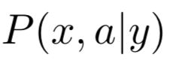
1990s-2010s: Statistical Machine Translation
Question: How to learn translation model ?
First, need large amount of parallel data (e.g. pairs of human-translated French/English sentences)
Break it down further: we actually want to consider where a is the alignment, i.e. word-level correspondence between French sentence x and English sentence y

Slide 9
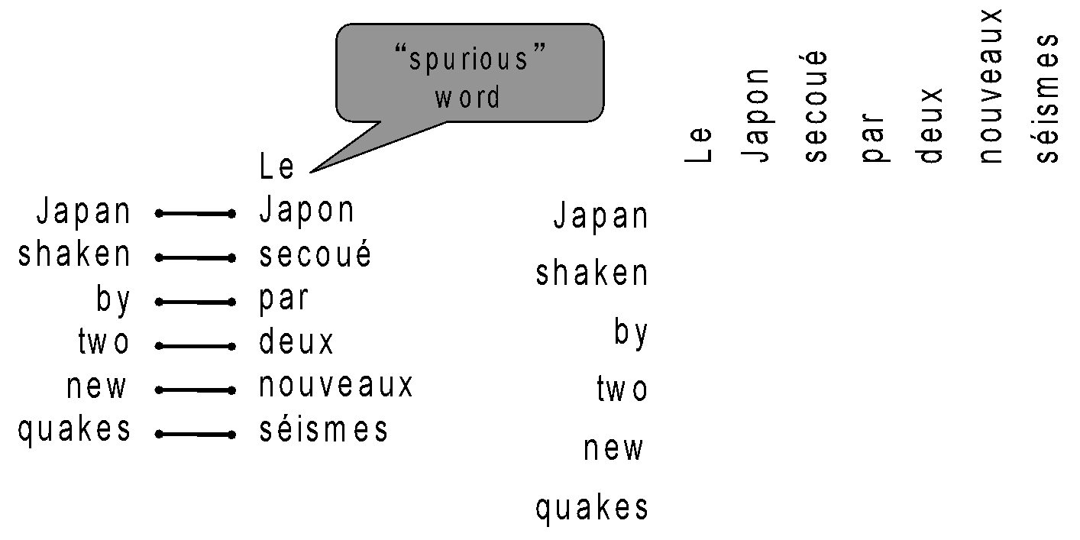
What is alignment?
Alignment is the correspondence between particular words in the translated sentence pair.
Note: Some words have no counterpart

Slide 10
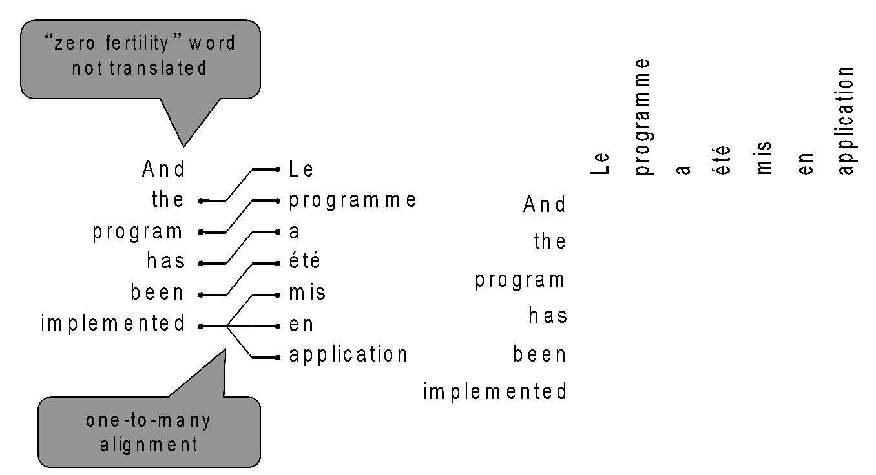
Alignment is complex
Alignment can be one-to-many (these are “fertile” words)

Slide 11
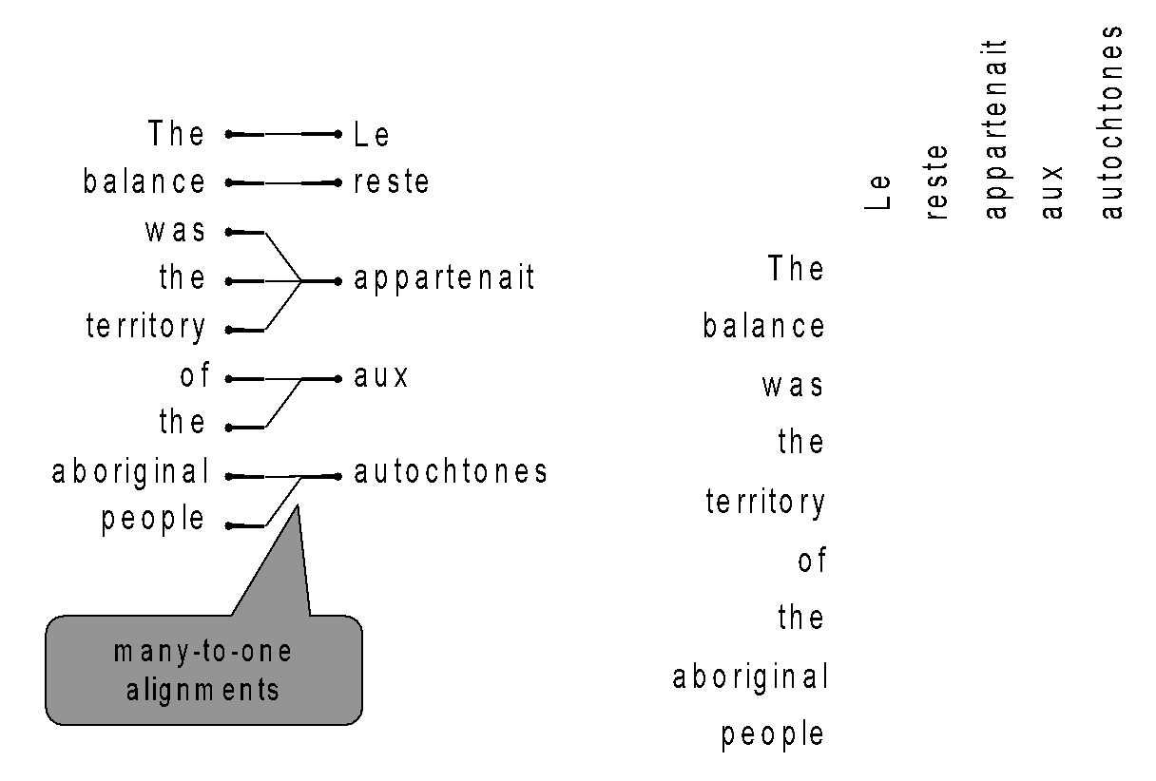
Alignment is complex
Alignment can be many-to-one

Slide 12
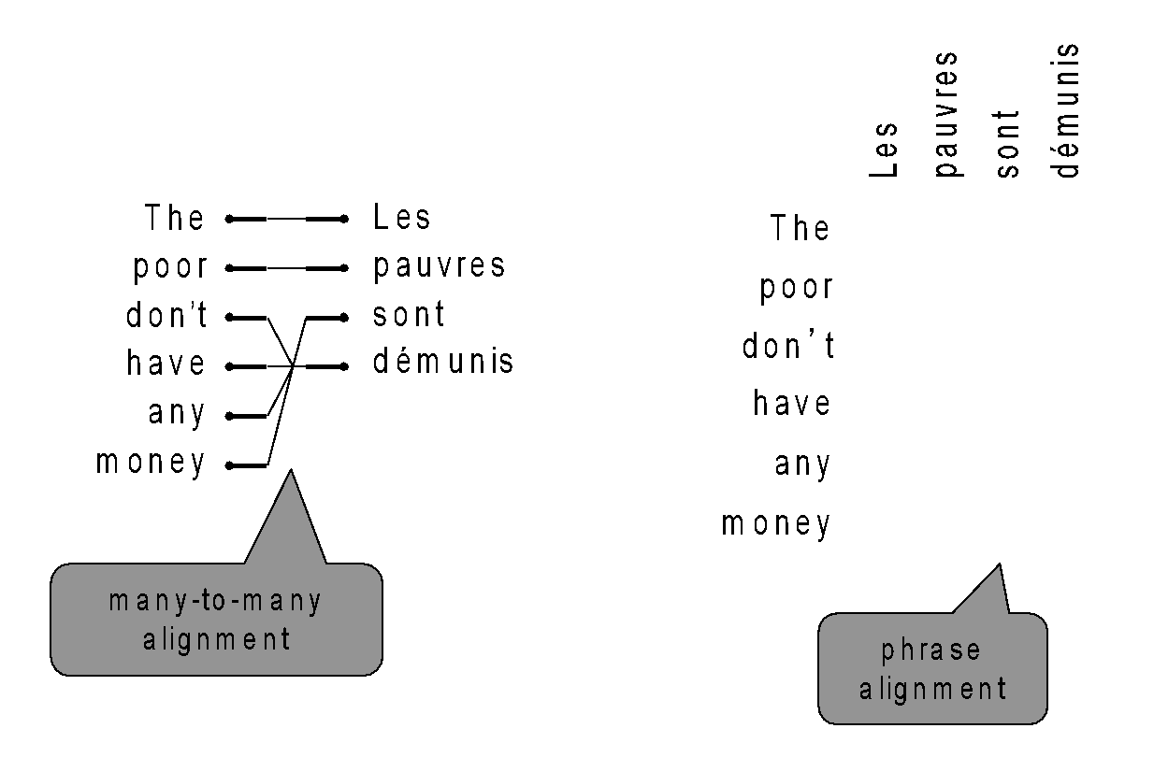
Alignment is complex
Alignment can be many-to-many (phrase-level)

Slide 13
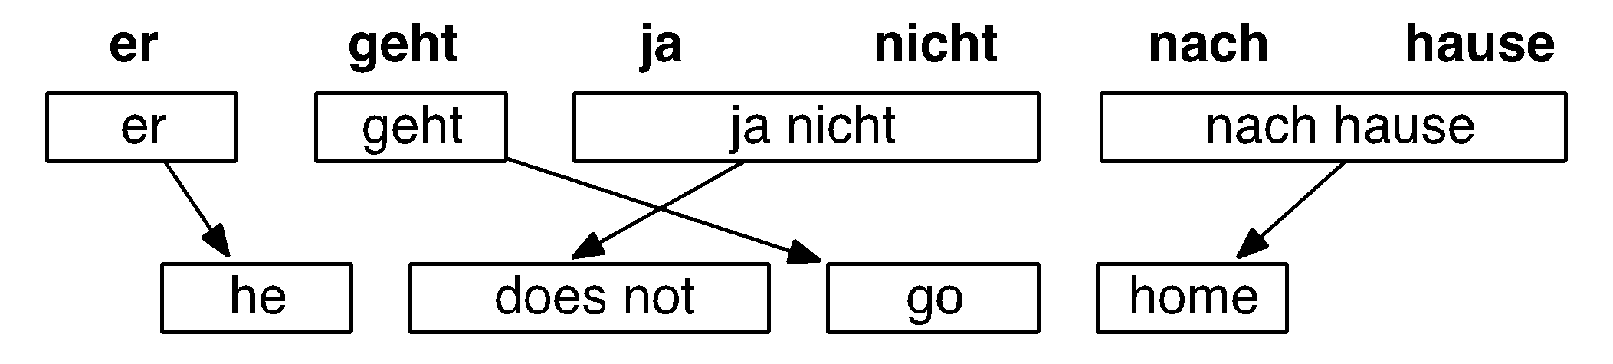
Searching for the best translation
Notes:
Credit Philipp Koehn
Ayer geet ya nicht nach hauser

Slide 14
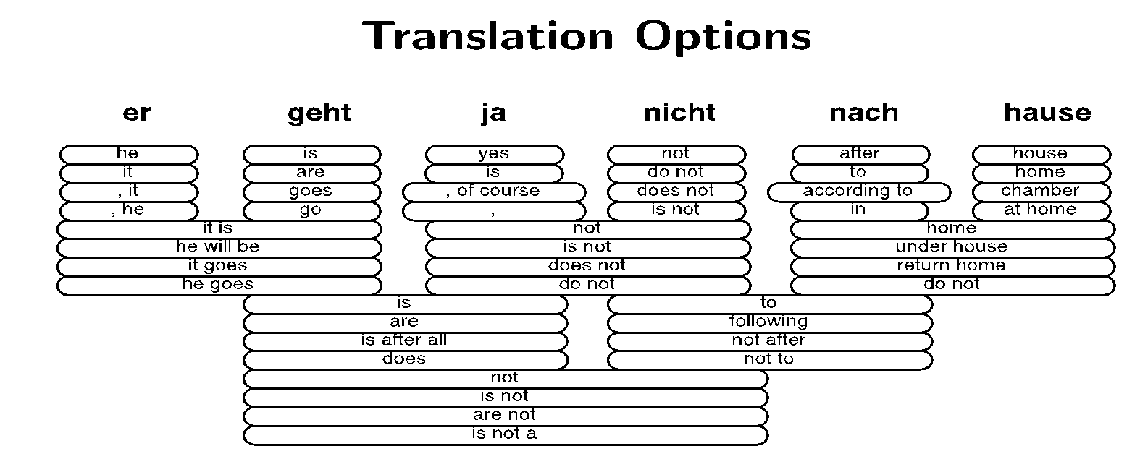
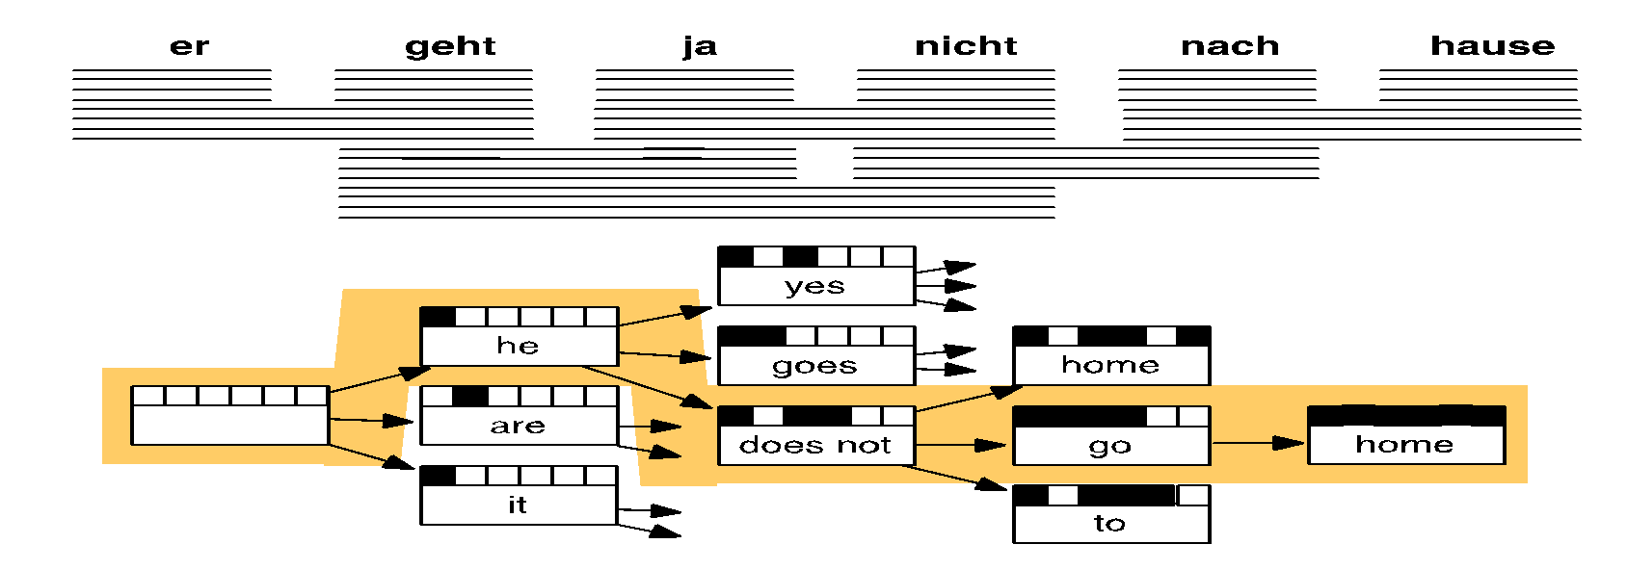
Searching for the best translation
Notes:
Credit Philipp Koehn

Slide 15
1990s-2010s: Statistical Machine Translation
SMT is a huge research field
The best systems are extremely complex
Hundreds of important details we haven’t mentioned here
Systems have many separately-designed subcomponents
Lots of feature engineering
Need to design features to capture particular language phenomena
Require compiling and maintaining extra resources
Like tables of equivalent phrases
Lots of human effort to maintain
Repeated effort for each language pair!
Notes:
Google SMT team was hundreds of people
20 mins to get to here

Slide 16
2014
(dramatic reenactment)

Slide 17

2014
Neural Machine
Translation
MT research
(dramatic reenactment)
Notes:
Dank meme

Slide 18
What is Neural Machine Translation?
Neural Machine Translation (NMT) is a way to do Machine Translation with a single neural network
The neural network architecture is called sequence-to-sequence (aka seq2seq) and it involves two RNNs.

Slide 19
Neural Machine Translation (NMT)
The sequence-to-sequence model
Target sentence (output)
Encoding of the source sentence. Provides initial hidden state for Decoder RNN.
the
poor
don’t
have any money <END>
argmax
argmax
argmax
argmax
argmax
argmax
argmax
Encoder RNN
Decoder RNN
les pauvres sont démunis
<START>
the
poor
don’t have any money
Source sentence (input)
Decoder RNN is a Language Model that generates target sentence conditioned on encoding.
Encoder RNN produces an encoding of the source sentence.
Note: This diagram shows test time behavior: decoder output is fed in as next step’s input
Notes:
Note there’s an embedding layer but it’s not in this picture
You have two separate sets of word embeddings, for the two languages
Note: these can be deep/bidir/lstm

Slide 20
Neural Machine Translation (NMT)
The sequence-to-sequence model is an example of a Conditional Language Model.
Language Model because the decoder is predicting the next word of the target sentence y
Conditional because its predictions are also conditioned on the source sentence x
NMT directly calculates :
Question: How to train a NMT system?
Answer: Get a big parallel corpus…
Probability of next target word, given target words so far and source sentence x
Notes:
NMT directly estimates p(y|x), whereas SMT modularized into translation model and language model

Slide 21
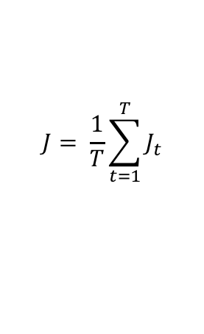
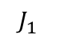
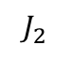
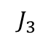
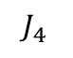
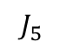
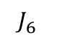
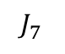
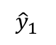
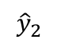
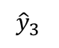
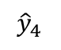
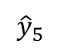
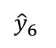
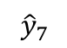
Training a Neural Machine Translation system
= negative log prob of “the”
= negative log prob of “have”
= negative log prob of <END>
= + + + + + +
Encoder RNN
Decoder RNN
les pauvres sont démunis
<START> the poor don’t have any money
Source sentence (from corpus)
Target sentence (from corpus)
Seq2seq is optimized as a single system.
Backpropagation operates “end to end”.
Notes:
This is all exactly like how you train a LM, except you also do the encoder part.

Slide 22
Better-than-greedy decoding?
We showed how to generate (or “decode”) the target sentence by taking argmax on each step of the decoder
This is greedy decoding (take most probable word on each step)
Problems?
the
poor
don’t
have any money <END>
argmax
argmax
argmax
argmax
argmax
argmax
argmax
<START>
the
poor
don’t have any money

Slide 23
Better-than-greedy decoding?
Greedy decoding has no way to undo decisions!
les pauvres sont démunis (the poor don’t have any money)
→ the ____
→ the poor ____
→ the poor are ____
Better option: use beam search (a search algorithm) to explore several hypotheses and select the best one

Slide 24
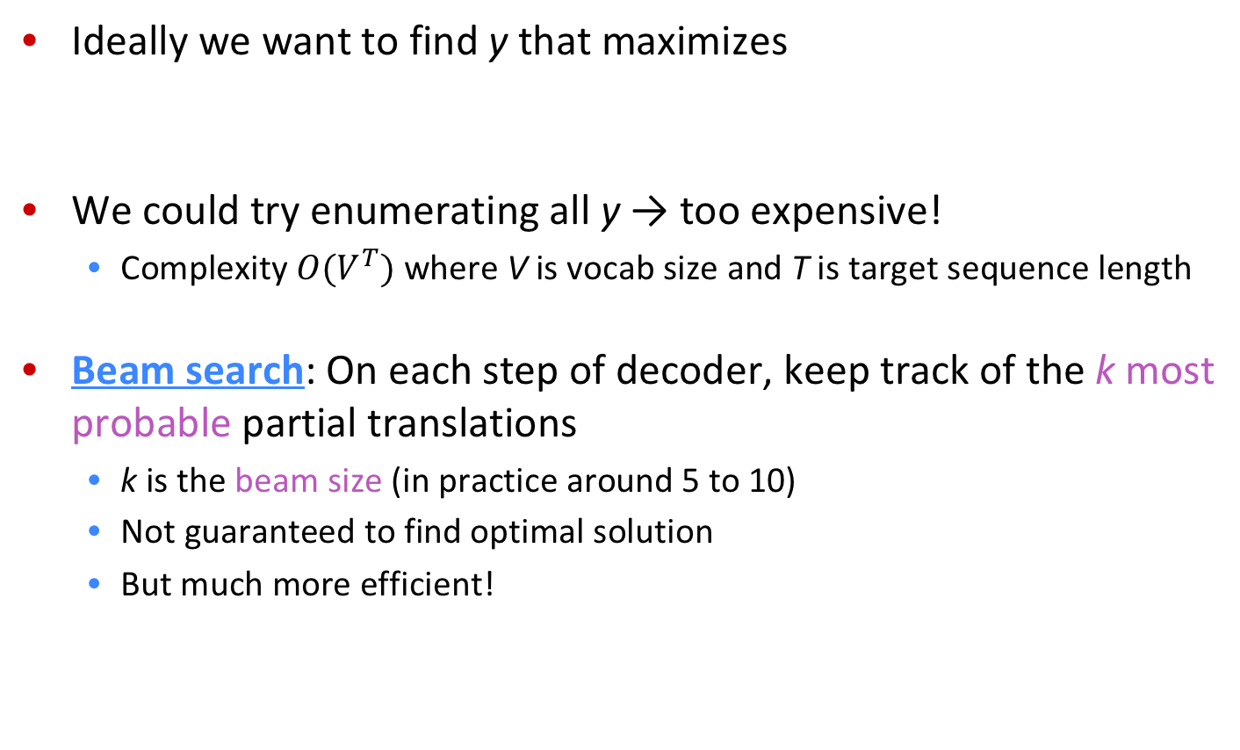
Beam search decoding

Slide 25
Beam search decoding: example
Beam size = 2
<START>

Slide 26
Beam search decoding: example
Beam size = 2
the
<START>
a

Slide 27
Beam search decoding: example
Beam size = 2
poor
the
people
<START>
poor
a
person

Slide 28
Beam search decoding: example
Beam size = 2
are
poor
the
don’t
people
<START>
person
poor
a
but
person

Slide 29
Beam search decoding: example
Beam size = 2
always
not
are
poor
the
don’t
have
people
take
<START>
person
poor
a
but
person

Slide 30
Beam search decoding: example
Beam size = 2
always
in
not
are
with
poor
the
don’t
have
people
take
any
<START>
enough
person
poor
a
but
person

Slide 31
Beam search decoding: example
Beam size = 2
always
in
not
are
with
poor
money
the
don’t
have
people
funds
take
any
<START>
enough
person
money
poor
a
but
funds
person

Slide 32
Beam search decoding: example
Beam size = 2
always
in
not
are
with
poor
money
the
don’t
have
people
funds
take
any
<START>
enough
person
money
poor
a
but
funds
person

Slide 33
Advantages of NMT
Compared to SMT, NMT has many advantages:
Better performance
More fluent
Better use of context
Better use of phrase similarities
A single neural network to be optimized end-to-end
No subcomponents to be individually optimized
Requires much less human engineering effort
No feature engineering
Same method for all language pairs
Notes:
Note google mt team size

Slide 34
Disadvantages of NMT?
Compared to SMT:
NMT is less interpretable
Hard to debug
NMT is difficult to control
For example, can’t easily specify rules or guidelines for translation
Safety concerns!
Notes:
Note google mt team size

Slide 35
Disadvantages of NMT?
Compared to SMT:
NMT is less interpretable
Hard to debug
NMT is difficult to control
For example, can’t easily specify rules or guidelines for translation
Safety concerns!
SMT is still very much in use!
Notes:
Note google mt team size

Slide 36
How do we evaluate Machine Translation?
BLEU (Bilingual Evaluation Understudy)
BLEU compares the machine-written translation to one or several human-written translation(s), and computes a similarity score based on:
n-gram precision (usually up to 3 or 4-grams)
Penalty for too-short system translations
BLEU is useful but imperfect
There are many valid ways to translate a sentence
So a good translation can get a poor BLEU score because it has low n-gram overlap with the human translation ☹
Notes:
More useful at the lower end of perf
We need better metrics; this is its own area of research

Slide 37
Beyond BLEU
Its own area of research
Thought: metric without reference texts

Slide 38
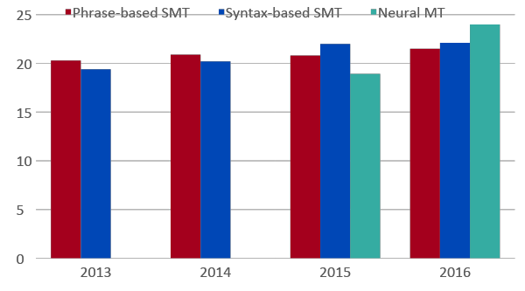
MT progress over time
[Edinburgh En-De WMT newstest2013 Cased BLEU; NMT 2015 from U. Montréal]
Source: http://www.meta-net.eu/events/meta-forum-2016/slides/09_sennrich.pdf

Slide 39
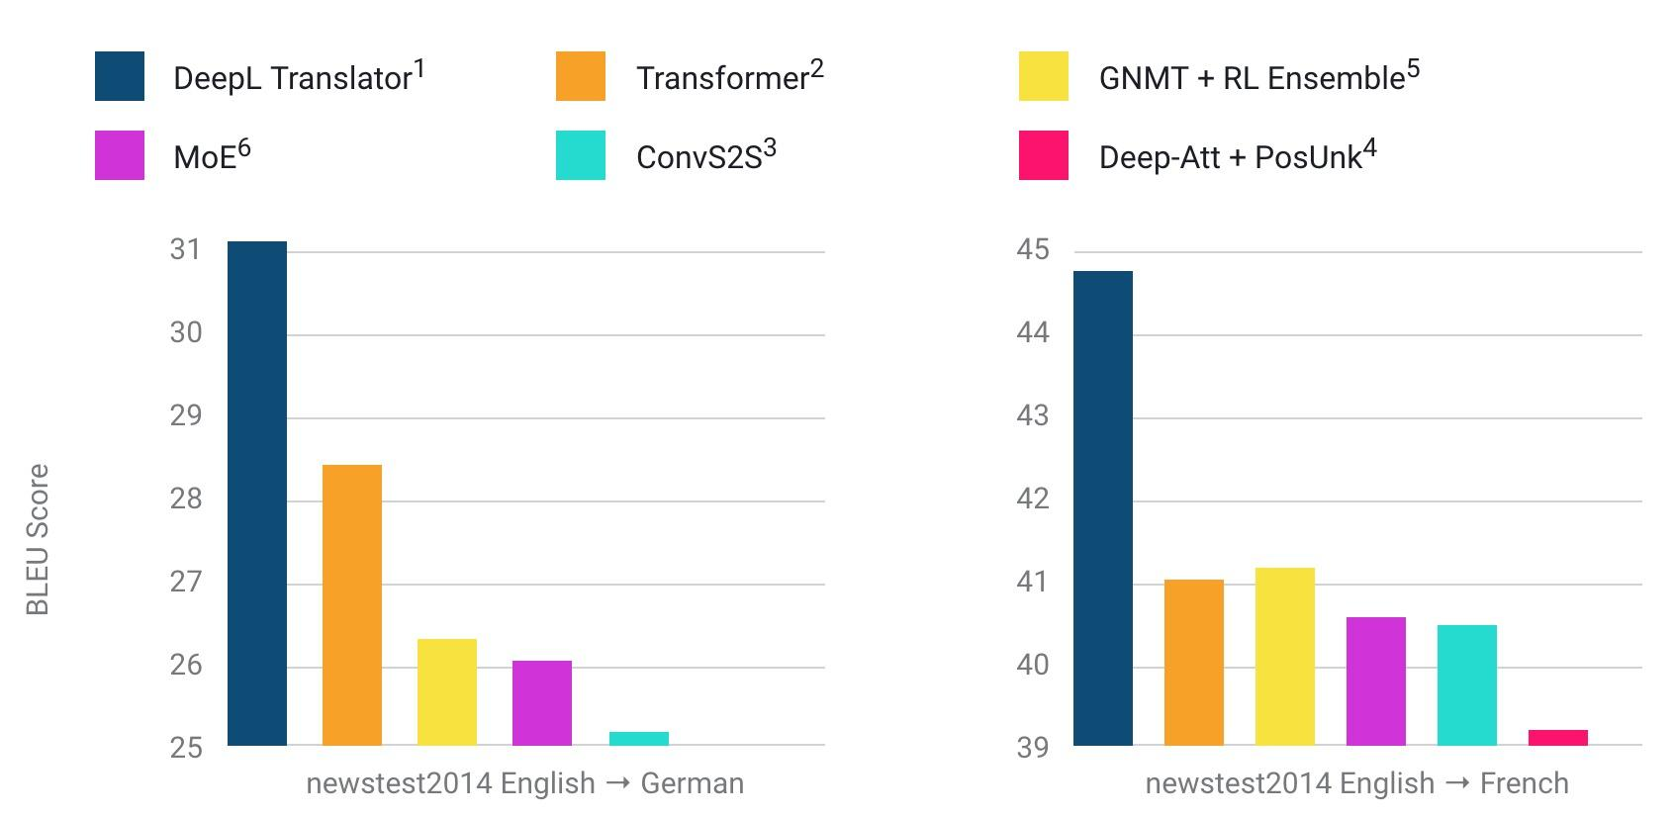
Data data data
Source: DeepL’s press release (Aug 2017)

Slide 40
NMT: the biggest success story of NLP Deep Learning
Neural Machine Translation went from a fringe research activity in 2014 to the leading standard method in 2016
2014: First seq2seq paper published
2016: Google Translate switches from SMT to NMT
This is amazing!
SMT systems, built by hundreds of engineers over many years, outperformed by NMT systems trained by a handful of engineers in a few months
Notes:
Note google mt team size, decades of work beaten by simple new system
you can make it deep, make the encoder bidirectional, obviously upgrade the RNN cell, feed in the source backwards, speed up the softmax computation, pretrain on other stuff, one network for all languages, many many tips and tricks link brain hyperparameter paper

Slide 41
So is Machine Translation solved?
Nope!
Many difficulties remain:
Out-of-vocabulary words
Domain mismatch between train and test data
Maintaining context over longer text
Low-resource language pairs

Slide 42



So is Machine Translation solved?
Nope!
Using common sense is still hard
?

Slide 43
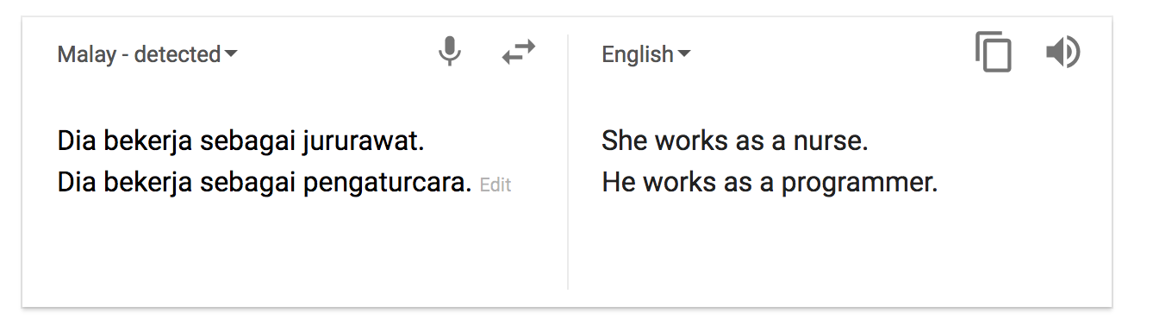
So is Machine Translation solved?
Nope!
NMT picks up biases in training data
Didn’t specify gender
Source: https://hackernoon.com/bias-sexist-or-this-is-the-way-it-should-be-ce1f7c8c683c

Slide 44
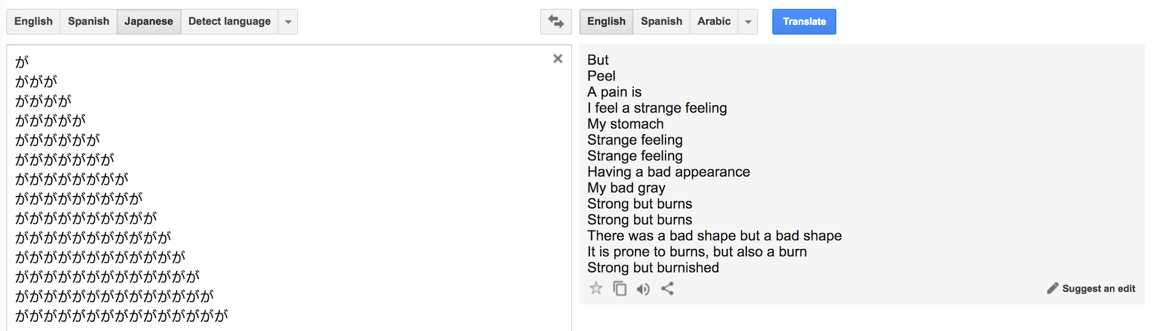
So is Machine Translation solved?
Nope!
Uninterpretable systems do strange things
Source: http://languagelog.ldc.upenn.edu/nll/?p=35120#more-35120

Slide 45
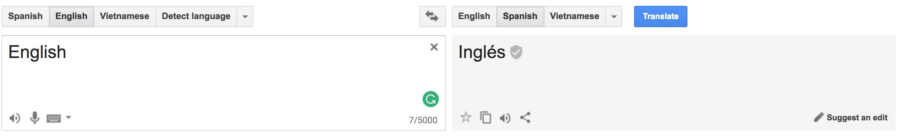
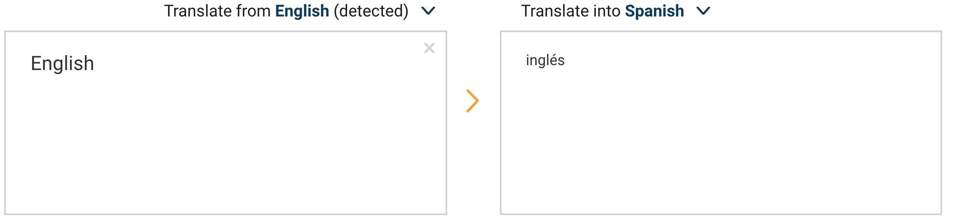
Google Translate vs DeepL (2/23/2018)
Google Translate: 0
DeepL: 0

Slide 46
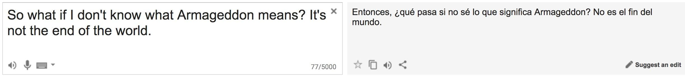
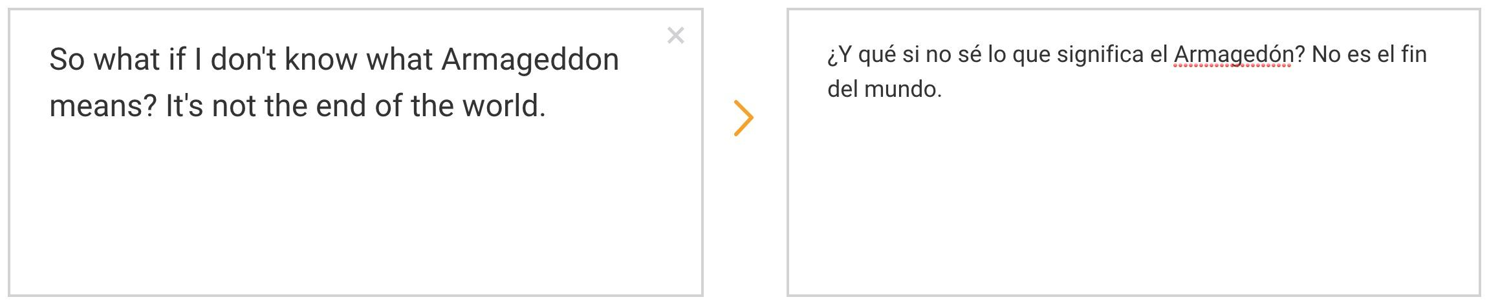
Google Translate vs DeepL (2/23/2018)
Google Translate: 0
DeepL: 0

Slide 47
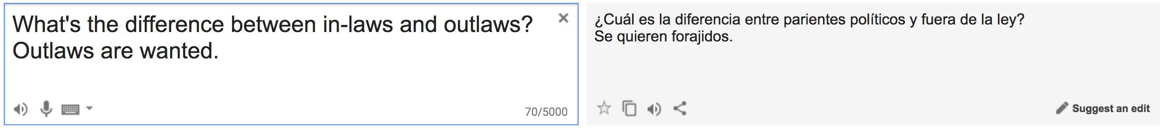
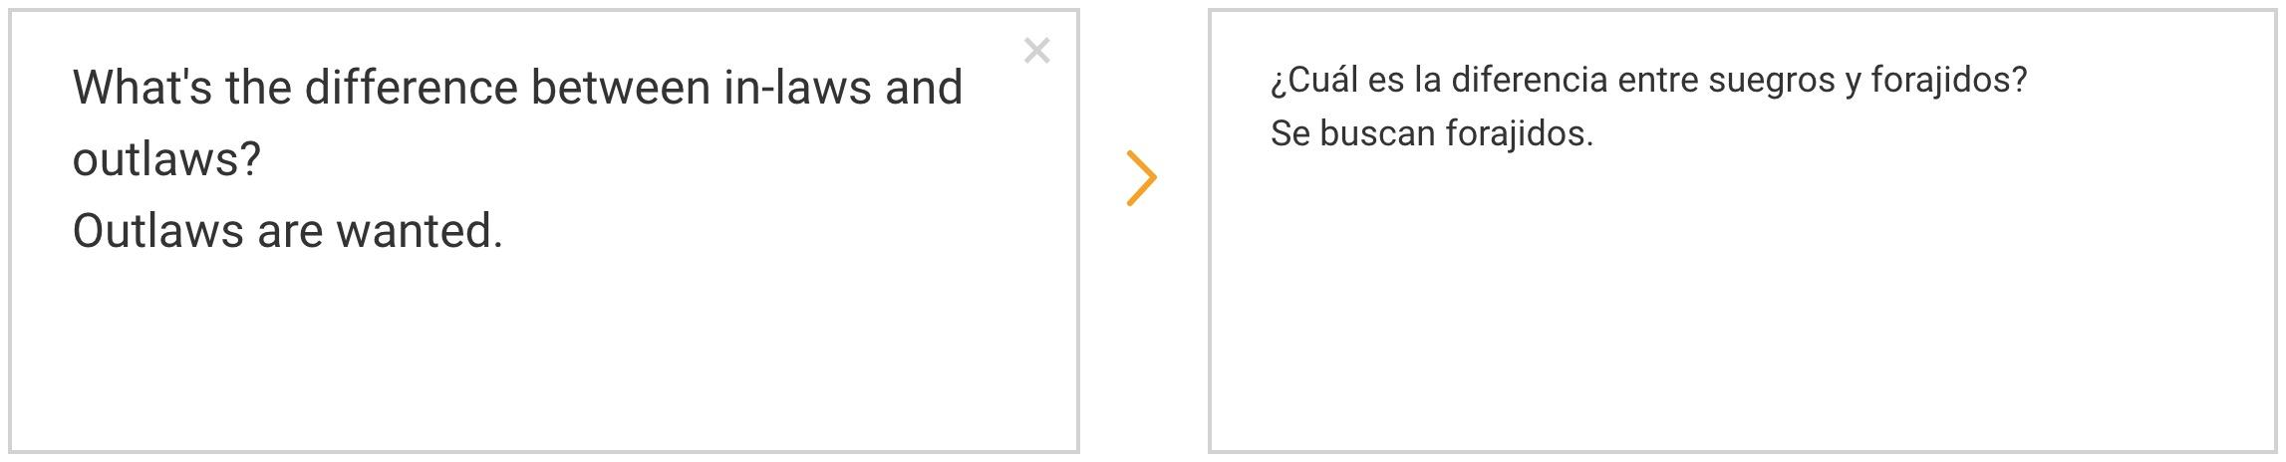
Google Translate vs DeepL (2/23/2018)
Google Translate: 0
DeepL: 0

Slide 48
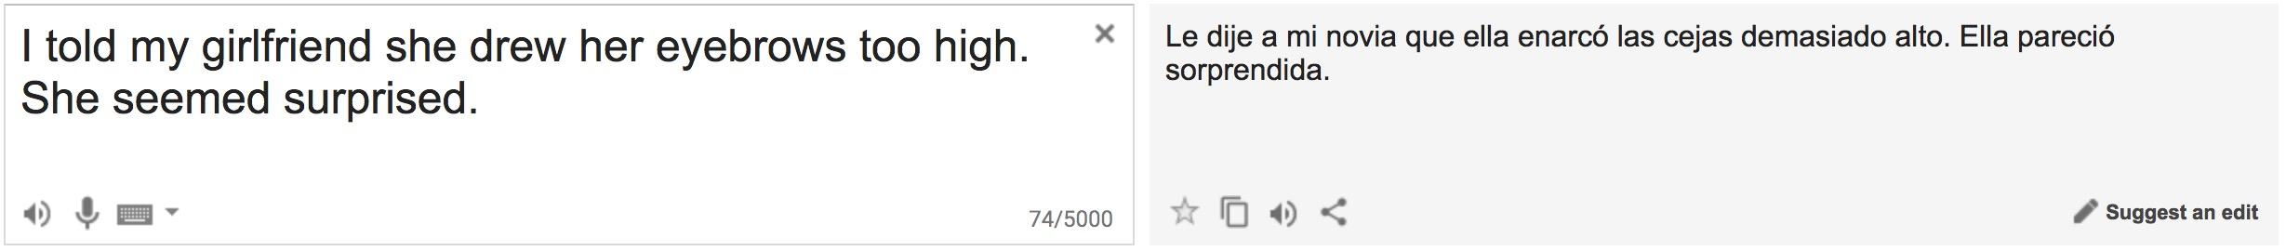
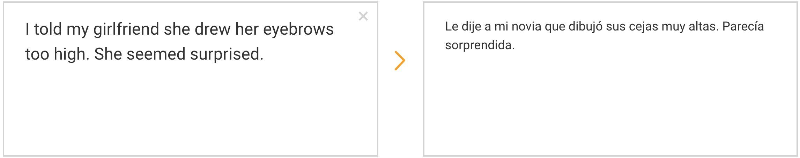
Google Translate vs DeepL (2/23/2018)
Google Translate: 0
DeepL: 0

Slide 49
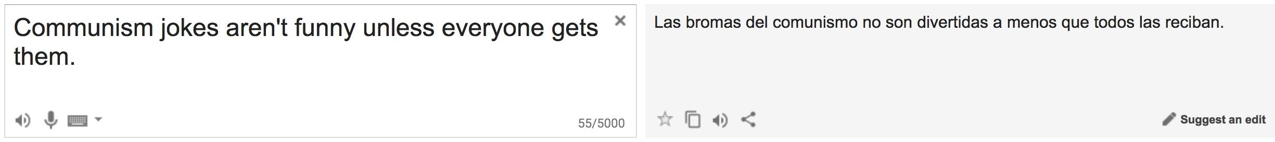
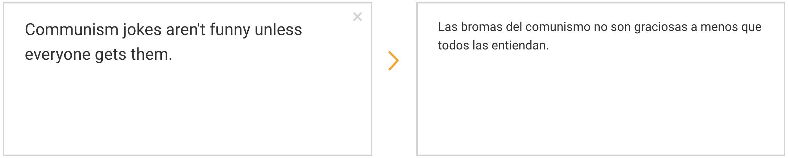
Google Translate vs DeepL (2/23/2018)
Google Translate: 0
DeepL: 0

Slide 50
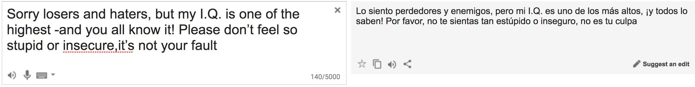
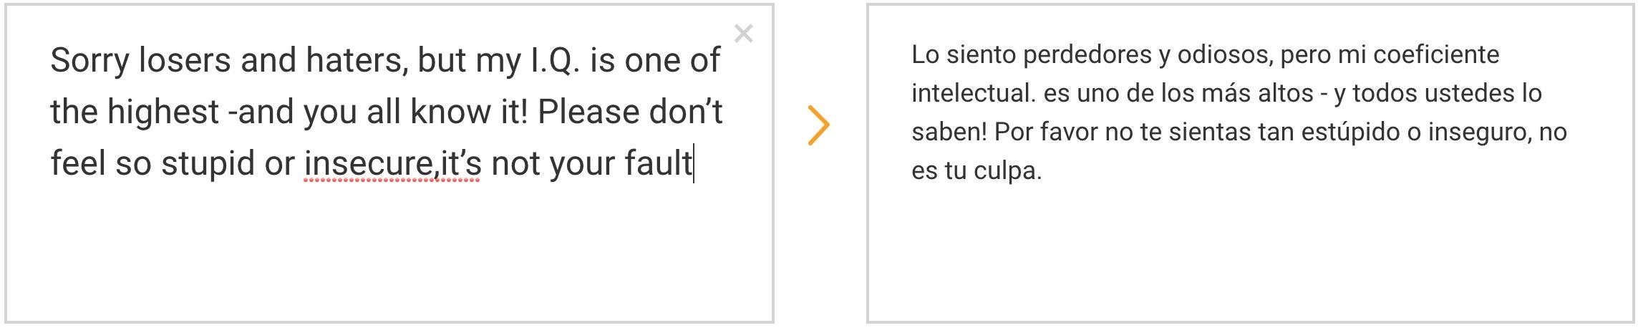
Google Translate vs DeepL (2/23/2018)
Google Translate: 0
DeepL: 0

Slide 51
NMT research continues
NMT is the flagship task for NLP Deep Learning
NMT research has pioneered many of the recent innovations of NLP Deep Learning
In 2018: NMT research continues to thrive
Researchers have found many, many improvements to the “vanilla” seq2seq NMT system we’ve presented today
But one improvement is so integral that it is the new vanilla…
ATTENTION
Notes:
Neural -> here: 40 min
You need 20 mins left now

Slide 52
Sequence-to-sequence: the bottleneck problem
Encoding of the source sentence.
Target sentence (output)
the poor don’t have any money <END>
Encoder RNN
Decoder RNN
les pauvres sont démunis
<START> the poor don’t have any money
Source sentence (input)
Problems with this architecture?
Notes:
Can anyone see any problems with this?

Slide 53
Sequence-to-sequence: the bottleneck problem
Encoding of the source sentence. This needs to capture all information about the source sentence.
Information bottleneck!
Target sentence (output)
the poor don’t have any money <END>
Encoder RNN
Decoder RNN
les pauvres sont démunis
<START> the poor don’t have any money
Source sentence (input)
Notes:
Can anyone see any problems with this?

Slide 54

Attention
Attention provides a solution to the bottleneck problem.
Core idea: on each step of the decoder, focus on a particular part of the source sequence

Slide 55
Sequence-to-sequence with attention
dot product
Attention scores
Encoder RNN
Decoder RNN
les pauvres sont démunis
<START>
Source sentence (input)
Notes:
Can anyone see any problems with this?

Slide 56
Sequence-to-sequence with attention
dot product
Attention scores
Encoder RNN
Decoder RNN
les pauvres sont démunis
<START>
Source sentence (input)
Notes:
Can anyone see any problems with this?

Slide 57
Sequence-to-sequence with attention
dot product
Attention scores
Encoder RNN
Decoder RNN
les pauvres sont démunis
<START>
Source sentence (input)
Notes:
Can anyone see any problems with this?

Slide 58
Sequence-to-sequence with attention
dot product
Attention scores
Encoder RNN
Decoder RNN
les pauvres sont démunis
<START>
Source sentence (input)
Notes:
Can anyone see any problems with this?

Slide 59
Sequence-to-sequence with attention
On this decoder timestep, we’re mostly focusing on the first encoder hidden state (”les”)
Attention distribution
Take softmax to turn the scores into a probability distribution
Attention scores
Encoder RNN
Decoder RNN
les pauvres sont démunis
<START>
Source sentence (input)
Notes:
Can anyone see any problems with this?

Slide 60
Sequence-to-sequence with attention
Attention output
Use the attention distribution to take a weighted sum of the encoder hidden states.
The attention output mostly contains information the hidden states that received high attention.
Attention distribution
Attention scores
Encoder RNN
Decoder RNN
les pauvres sont démunis
<START>
Source sentence (input)
Notes:
Can anyone see any problems with this?

Slide 61
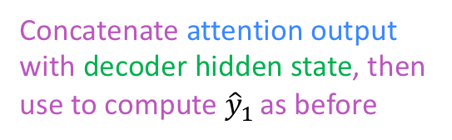
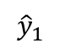
Sequence-to-sequence with attention
Attention output
the
Attention distribution
Attention scores
Encoder RNN
Decoder RNN
les pauvres sont démunis
<START>
Source sentence (input)
Notes:
Can anyone see any problems with this?

Slide 62
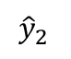
Sequence-to-sequence with attention
Attention output
poor
Attention distribution
Attention scores
Encoder RNN
Decoder RNN
les pauvres sont démunis
<START>
the
Source sentence (input)
Notes:
Can anyone see any problems with this?

Slide 63
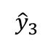
Sequence-to-sequence with attention
Attention output
don’t
Attention distribution
Attention scores
Encoder RNN
Decoder RNN
les pauvres sont démunis
<START>
the
poor
Source sentence (input)
Notes:
Can anyone see any problems with this?

Slide 64
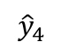
Sequence-to-sequence with attention
Attention output
have
Attention distribution
Attention scores
Encoder RNN
Decoder RNN
les pauvres sont démunis
<START>
the
poor
don’t
Source sentence (input)
Notes:
Can anyone see any problems with this?

Slide 65
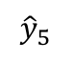
Sequence-to-sequence with attention
Attention output
any
Attention distribution
Attention scores
Encoder RNN
Decoder RNN
les pauvres sont démunis
<START>
the
poor
don’t
have
Source sentence (input)
Notes:
Can anyone see any problems with this?

Slide 66
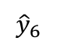
Sequence-to-sequence with attention
Attention output
money
Attention distribution
Attention scores
Encoder RNN
Decoder RNN
les pauvres sont démunis
<START>
the
poor
don’t
have
any
Source sentence (input)
Notes:
Can anyone see any problems with this?

Slide 67
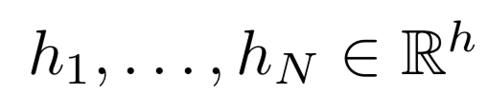





Attention: in equations
We have encoder hidden states
On timestep t, we have decoder hidden state
We get the attention scores for this step:
We take softmax to get the attention distribution for this step (this is a probability distribution and sums to 1)
We use to take a weighted sum of the encoder hidden states to get the attention output
Finally we concatenate the attention output with the decoder hidden state and proceed as in the non-attention seq2seq model

Slide 68

Attention is great
Attention significantly improves NMT performance
It’s very useful to allow decoder to focus on certain parts of the source
Attention solves the bottleneck problem
Attention allows decoder to look directly at source; bypass bottleneck
Attention helps with vanishing gradient problem
Provides shortcut to faraway states
Attention provides some interpretability
By inspecting attention distribution, we can see what the decoder was focusing on
We get alignment for free!
This is cool because we never explicitly trained an alignment system
The network just learned alignment by itself

Slide 69
Recap
We learned the history of Machine Translation (MT)
Since 2014, Neural MT rapidly replaced intricate Statistical MT
Sequence-to-sequence is the architecture for NMT (uses 2 RNNs)
Attention is a way to focus on particular parts of the input
Improves sequence-to-sequence a lot!

Slide 70
Sequence-to-sequence is versatile!
Sequence-to-sequence is useful for more than just MT
Many NLP tasks can be phrased as sequence-to-sequence:
Summarization (long text → short text)
Dialogue (previous utterances → next utterance)
Parsing (input text → output parse as sequence)
Code generation (natural language → Python code)

Slide 71
Next class
Transformers (guest lecture by Lukasz Kaiser)

